Slide 1
PCIe controller Top module diagram
2020311096 김준태
2020311400 박세빈
2020310727 유승현
2020310663 홍성필

Slide 2
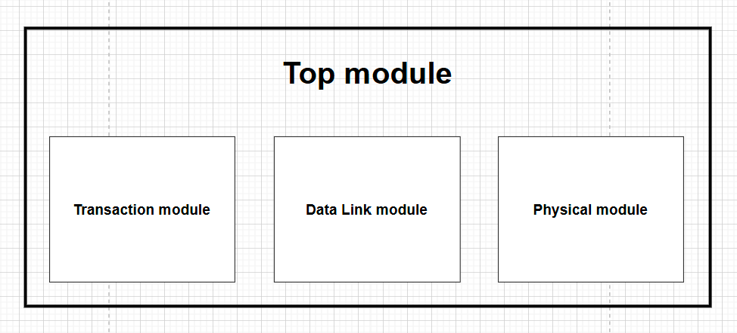
>>
Top module

Slide 3
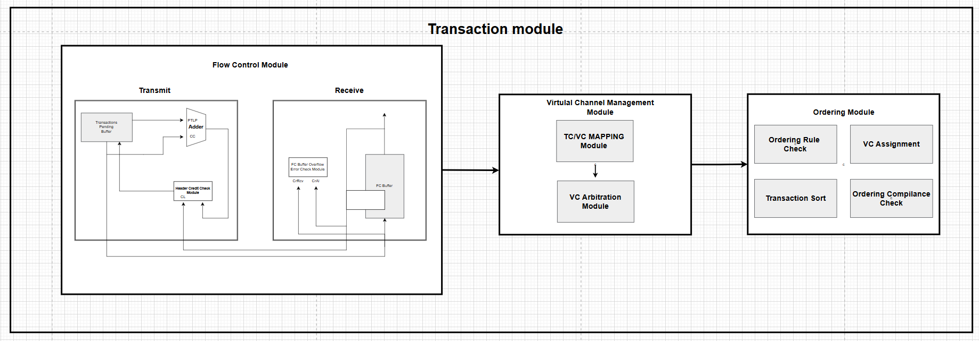
>>
Transaction module
Part 1

Slide 4
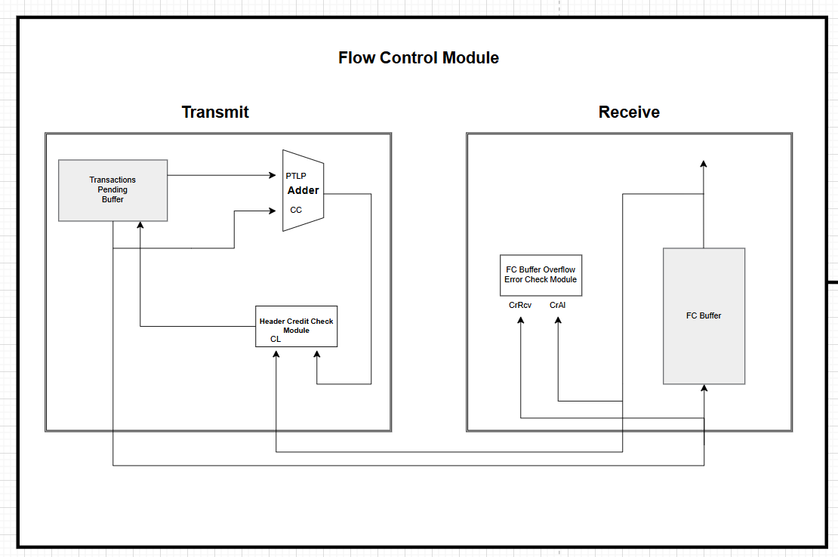
>>
Flow Control module
Part 1-1

Slide 5
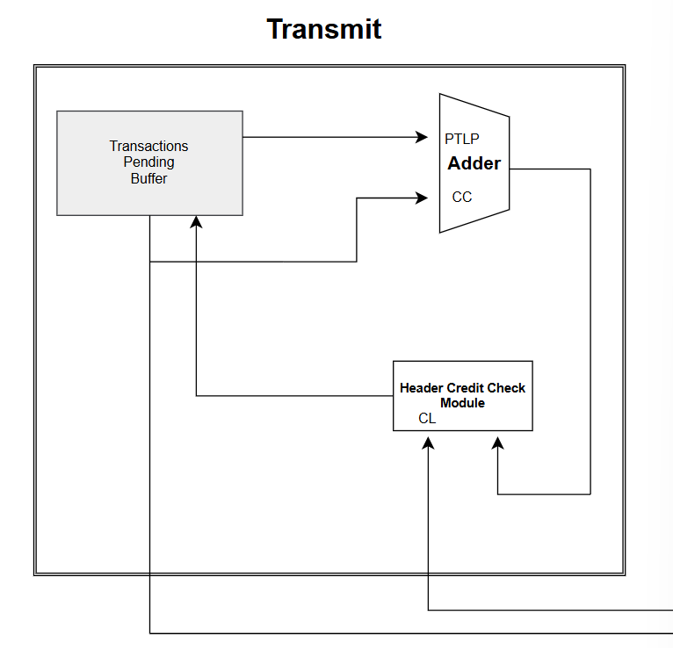
>>
Transmit module
Part 1-1

Slide 6
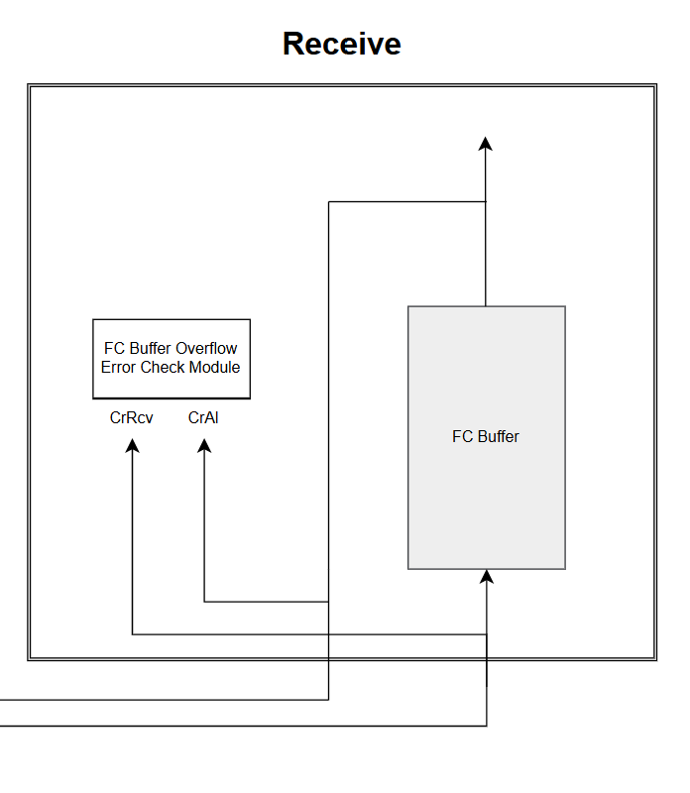
>>
Receive module
Part 1-1

Slide 7
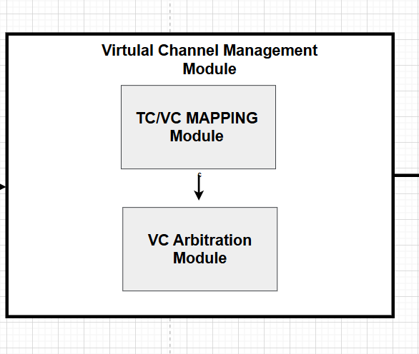
>>
Virtual Channel Management module
Part 1-2

Slide 8
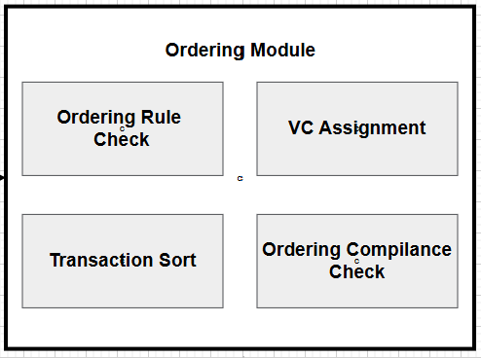
>>
Ordering Module
Part 1-3

Slide 9
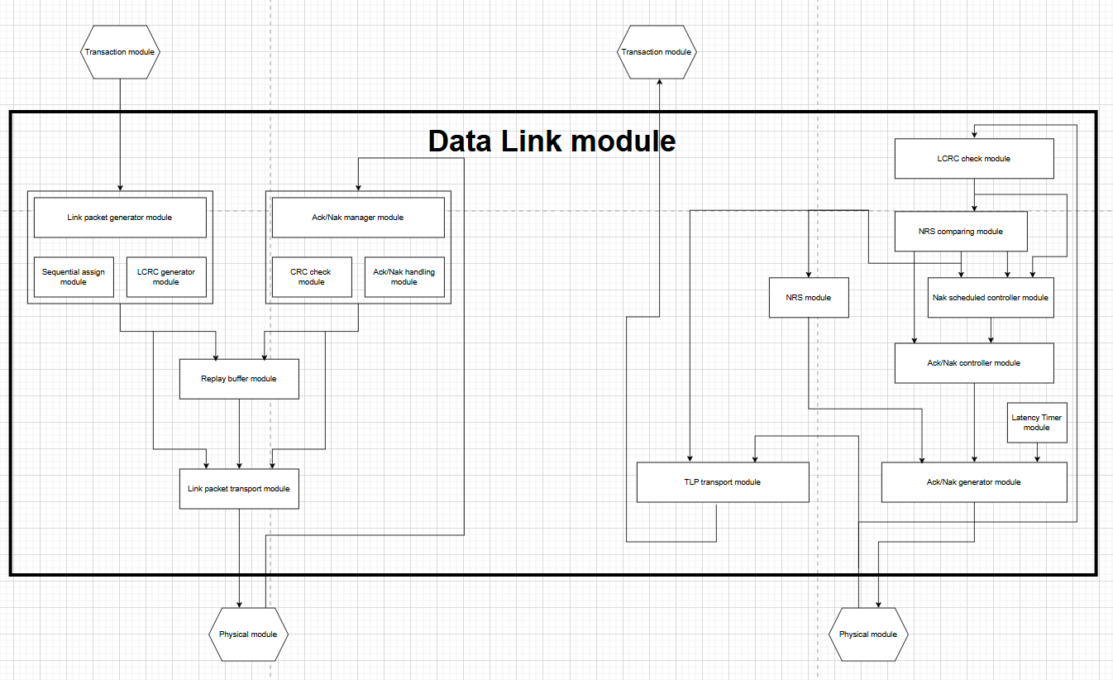
>>
Data Link module
Part 2

Slide 10
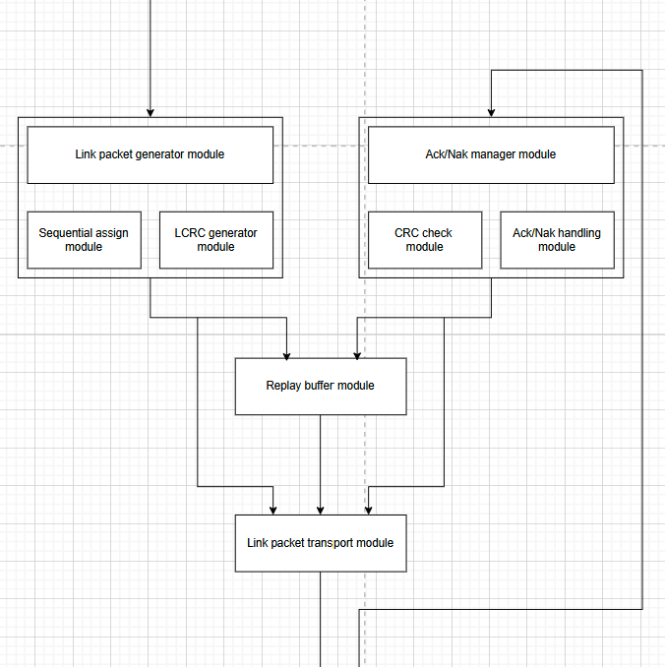
>>
Data Link TX module
Part 2-1

Slide 11
>>
Data Link TX module
Part 2-1

Slide 12
>>
Data Link TX module
Part 2-1

Slide 13
>>
Data Link TX module
Part 2-1

Slide 14
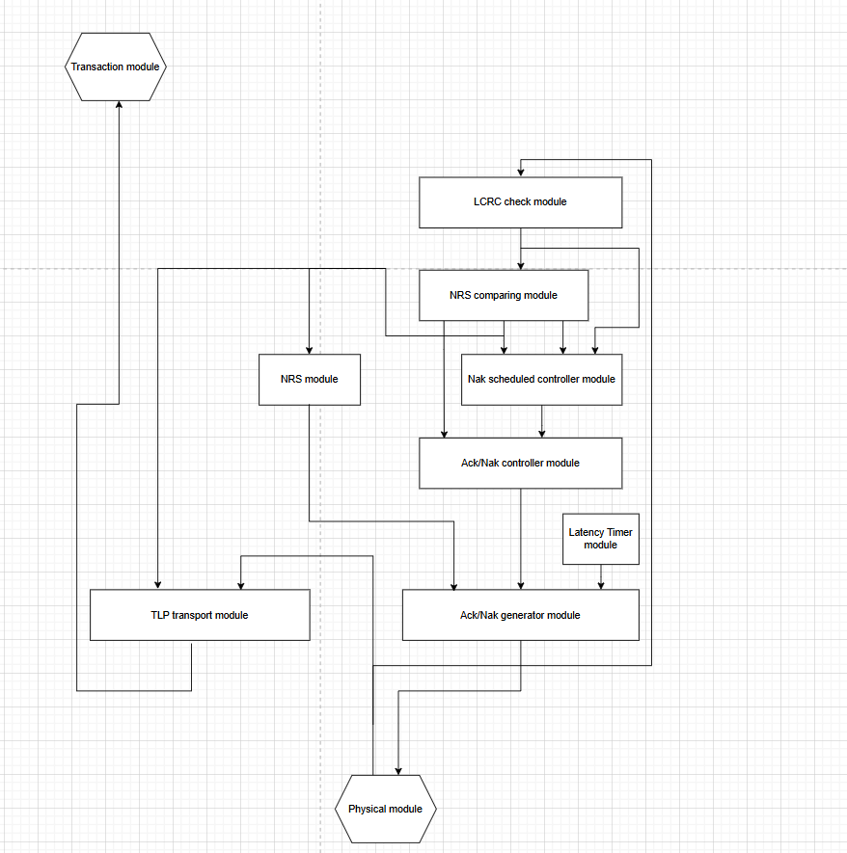
>>
Data Link RX module
Part 2-2

Slide 15
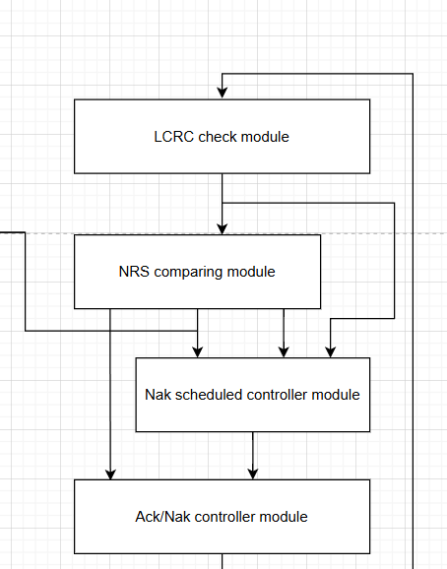
>>
Data Link RX module
Part 2-2

Slide 16
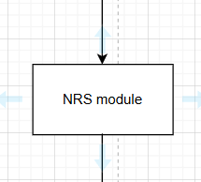
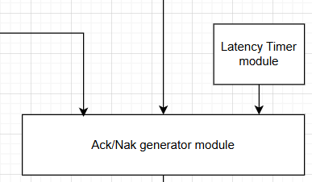
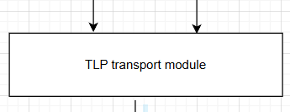
>>
Data Link RX module
Part 2-2

Slide 17
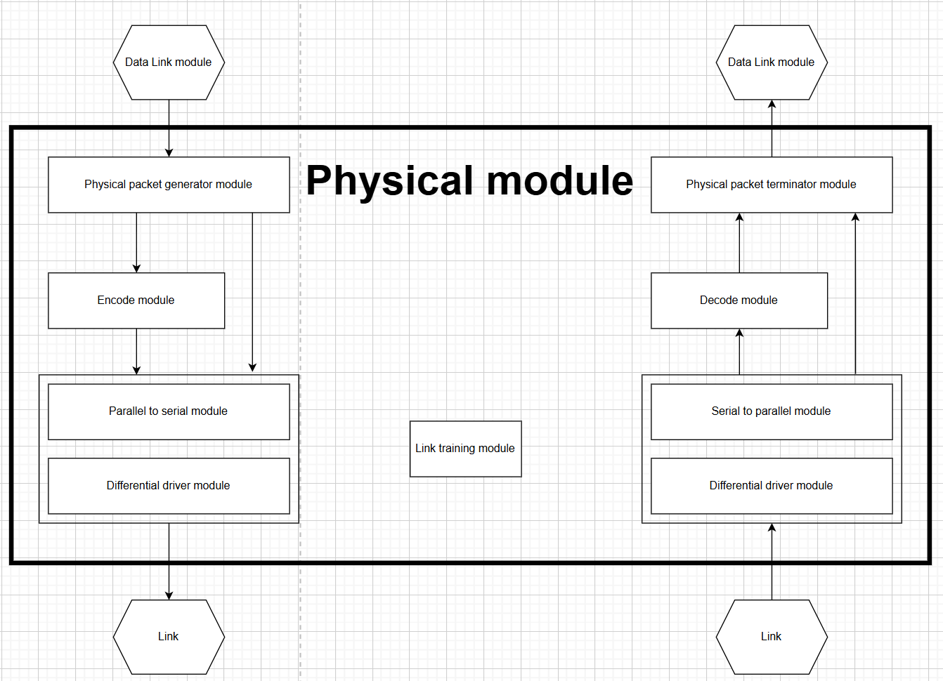
>>
Physical module
Part 3

